Slide 1
Machine Learning Foundations: A Case Study Approach
Note for:
Introduction

Slide 2
Before the note …
使用課程投影片並註記 note
大部份會註記在 pdf 上
(這個檔案例外，註記太少)
前面的章節許多地方可以跟 Andrew Ng 的 machine learning 互相搭配補充 (若能，建議正規的上該課，雖然跳著補充似乎也還可以)
有時會擷取相關內容 (若沒空聽課就看字吧)
例外：本篇的補充 (華盛頓大學取消該些內容了)
由於有 overall 的課程介紹，或許 note 會重複
Notes:
note 可能會是個人見解，僅供參考~
此外還有 Andrew Ng 的 deep learning
https://www.coursera.org/specializations/deep-learning
前三部份可以接續原本課程裡的 Neural Networks 繼續深入觀念與基本實作
後兩部份是 deep learning 的特殊模型

Slide 3
Machine learning
One cannot do the inference without assumptions
演算法五花八門，最重要的關鍵是去了解該演算法的假設
知道其假設，再了解細節、特性、優缺點
假設通常針對資料或目的
Notes:
林軒田老師當初在課上 (第一堂課?) 有提到類似的這麼一句話 (英文) (詳細的用字因年代久遠已不可考)

Slide 4
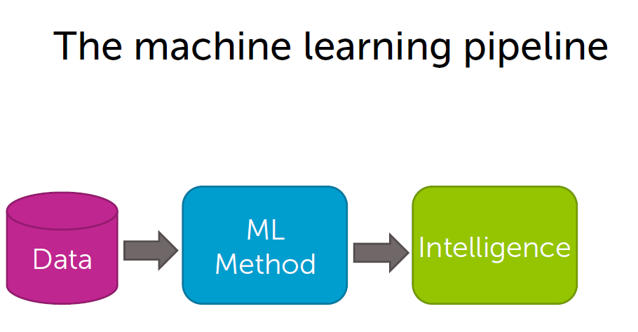
Page 6
方法：五花八門
資料本身
不帶資訊
智慧
目的：
較佳的決策
源頭：資料

Slide 5
Before machine learning
先了解目的
要達成的目標為何
是否要運用 machine learning
要有資料
沒有資料不能成事
資料整理? (廣義的整理，不牽涉學習)
Notes:
廣義的整理：資料的格式、完整性、單位、區域性、視覺化…
進一步 (這裡的狹義) 整理則是指 “提取特徵 for training”

Slide 6
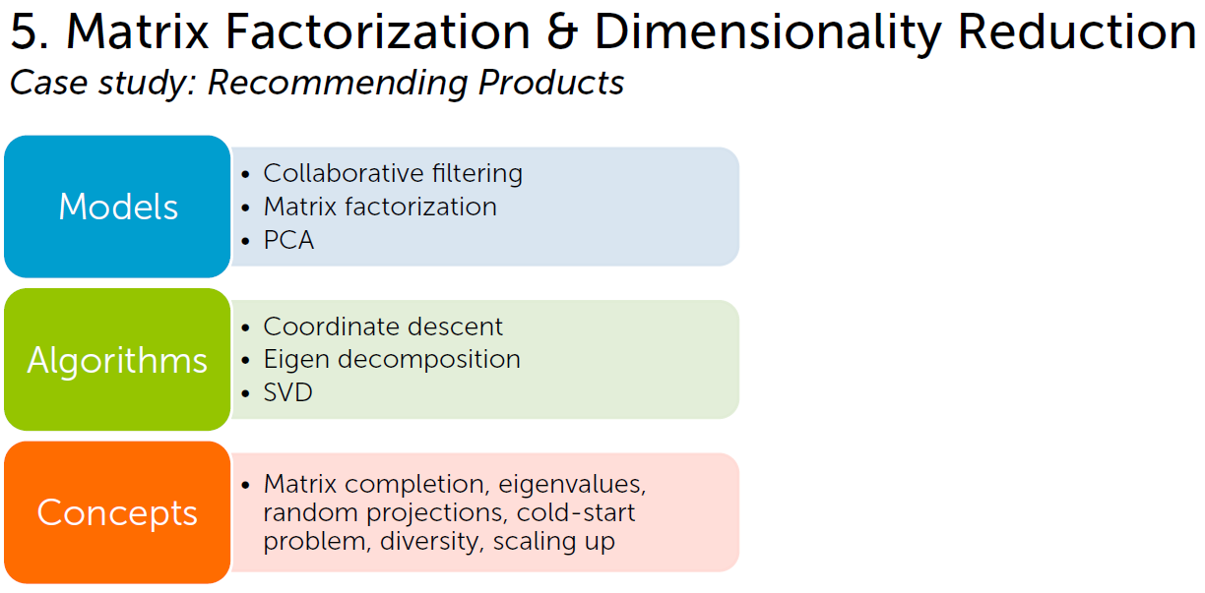
Page 21 (被取消的 part 5)

Slide 7
Machine learning (Andrew Ng)
Week 9 後半段
Recommender Systems
Predicting Movie Ratings:
Problem Formulation
Content-based Recommendations
Collaborative Filtering:
Collaborative Filtering
Collaborative Filtering Algorithm
Low Rank Matrix Factorization:
Vectorization: Low Rank Matrix Factorization
Implementation Detail: Mean Normalization
Notes:
Recommender Systems:
When you buy a product online, most websites automatically recommend other products that you may like. Recommender systems look at patterns of activities between different users and different products to produce these recommendations. In this module, we introduce recommender algorithms such as the collaborative filtering algorithm and low-rank matrix factorization.

Slide 8
Machine learning (Andrew Ng)
Week 8 後半段
Dimensionality Reduction
Motivation:
Motivation I: Data Compression
Motivation II: Visualization
Principal Component Analysis:
PCA Problem Formulation
PCA Algorithm
Applying PCA:
Reconstruction from Compressed Representation
Choosing the Number of Principal Components
Advice for Applying PCA

Slide 9
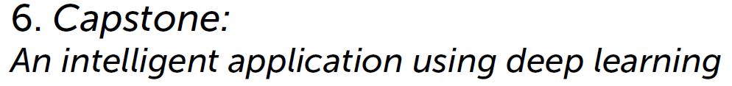
Page 22 (被取消的 part 6)
Deep Learning Specialization by Andrew Ng
Notes:
這裡只是提出 deep learning 的課程，與華盛頓大學的原意 (打造 application) 略有出入

